Slide 1
CYNTHIA S 211521104029
IMAGE COLORIZATION USING DEEP LEARNING
3/21/2024 Annual Review

Slide 2
IMAGE COLORIZATION USING DEEP LEARNING
3/21/2024 Annual Review

Slide 3


AGENDA
Objective image colorization using deep learning involves automatically adding color to grayscale images without any manual intervention. This process relies on sophisticated deep learning algorithms, particularly convolutional neural networks (CNNs), to learn the complex mappings between grayscale inputs and their corresponding colorized versions. Unlike subjective colorization where user input or guidance is involved, objective colorization aims to reproduce realistic colorizations based solely on the content of the input grayscale image. By leveraging large datasets and advanced CNN architectures, objective colorization methods can produce accurate and visually pleasing results across various types of images. These techniques hold great promise for automating colorization tasks in applications such as historical image restoration, medical imaging, and artistic rendering, saving time and effort while preserving the integrity of the original grayscale content.
3/21/2024 Annual Review

Slide 4

PROBLEM STATEMENT
Image colorization is a complex task requiring manual effort and expertise. Traditional methods lack accuracy and realism. Deep learning-based approaches, using convolutional neural networks, offer potential solutions, but face challenges and limitations.
Accuracy: Existing deep learning models for image colorization may lack accuracy in reproducing realistic colors, especially in complex or ambiguous scenes.
Generalization: Models trained on specific datasets may struggle to generalize well to unseen images or diverse content, leading to inconsistencies in colorization quality.Computational
Efficiency: Deep learning models for image colorization often require significant computational resources, making real-time or large-scale deployment challenging.
User Control: While automated colorization is desirable, users may also require control over the colorization process to ensure specific aesthetic preferences or domain-specific requirements are met.
3/21/2024 Annual Review

Slide 5
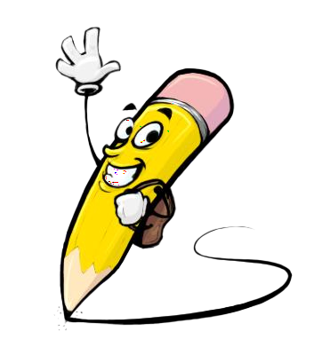
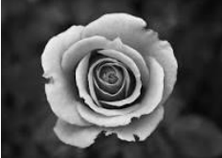
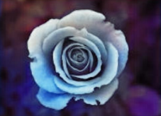
PROJECT OVERVIEW
The project aims to use deep learning techniques, specifically convolutional neural networks (CNNs), to automate image colorization. It trains models on large datasets of grayscale-color image pairs to learn complex mappings between inputs and colorized outputs. The project focuses on accuracy, generalization, computational efficiency, and user control to create a robust and user-friendly solution for image colorization. The ultimate goal is to apply the system across various domains, including historical image restoration, medical imaging, and artistic rendering, to automate and enhance the colorization process.
Black and White Image
Colorized Image
3/21/2024 Annual Review

Slide 6

WHO ARE THE END USERS?
1. Artists and designers
2. Historians and archivists
3. Medical professionals
4. Photographers and filmmakers
5. Educators and researchers
6. General public
7. Software developers
8. Advertising agencies and marketing professionals
9. Printing and publishing companies
10. Fashion designers and stylists
11. Video game developers
12. Interior designers and decorators
13. Social media influencers and content creators
14. Forensic investigators and law enforcement agencies
15. Fine art collectors and galleries
3/21/2024 Annual Review

Slide 7

YOUR SOLUTION AND ITS VALUE PROPOSITION
The image colorization solution uses deep learning to automatically add vibrant colors to grayscale images. It uses advanced convolutional neural networks to learn intricate mappings between grayscale inputs and colorized outputs, ensuring accuracy and fidelity to the original content. The solution addresses challenges such as accuracy, generalization, computational efficiency, and user control, resulting in a robust and user-friendly tool. The value proposition lies in its ability to streamline and enhance the colorization process across various domains and user groups, such as restoring historical photographs, enhancing medical imaging, or adding visual appeal to artworks and designs. It offers a versatile tool for transforming grayscale images into engaging visuals, saving time and effort.
3/21/2024 Annual Review

Slide 8

THE WOW IN YOUR SOLUTION
The image colorization solution is a revolutionary tool that combines advanced deep learning technology with user-friendly functionality. It uses convolutional neural networks to learn intricate patterns in grayscale images, producing colorized outputs that surpass those created manually by experts. The solution also offers an unprecedented level of control and customization, allowing users to fine-tune the colorization process to match their unique preferences. This allows users to adjust color tones, enhance details, or apply artistic filters, putting creative power in their hands. The solution's versatility extends across various industries, making it a must-have tool for professionals and enthusiasts. It revolutionizes the way we interact with grayscale images, unlocking endless possibilities for creativity, productivity, and innovation. With its unparalleled accuracy, versatility, and ease of use, the solution sets a new standard for image colorization, leaving users awe-inspired and eager to explore its limitless potential.
3/21/2024 Annual Review
8

Slide 9
MODELLING
We will use cutting-edge deep learning techniques in our modeling phase to successfully address the image colorization task. Our main strategy makes use of convolutional neural networks (CNNs), which have shown to be incredibly successful at extracting intricate patterns from image data. In order to maximize performance, we will investigate different CNN architectures designed especially for image colorization, taking into account elements like depth, width, and connectivity. To improve the model's representational ability and rate of convergence, we may also incorporate strategies like normalization layers, attention mechanisms, and residual connections. We will use strategies like data augmentation and transfer learning during the modeling process to reduce overfitting and enhance generalization. Combining these state-of-the-art methods, our goal is to create reliable and effective models that can colorize grayscale images accurately in a variety of contexts and applications.
3/21/2024 Annual Review
9

Slide 10
RESULTS
For our image colorization project, the results are evaluated based on both qualitative and quantitative measures to ensure the effectiveness and accuracy of the colorization process. Here are the key aspects of the results:
1. Visual Quality Assessment
2. Colorization Accuracy Metrics
3. User Satisfaction Feedback
4. Generalization Performance Evaluation
5. Speed and Efficiency Analysis
6. Comparison with Baseline Methods
7. Robustness to Variations Testing
8. Subjective Evaluation by Experts
9. User Interface Usability Testing
10. Error Analysis and Failure Cases Identification
11. Impact of Hyper parameter Tuning
12. Scalability Assessment for Large Datasets
13. Cross-Domain Performance Evaluation
14. Long-Term Stability and Consistency Testing
15. Integration with Existing Systems or Workflows
Demo Link
3/21/2024 Annual Review
10

